Slide 1
Nutrient Work Group Update
May 19, 2023
Notes:
Brief history of SB-358 signed into state law after 2021 LEG; directed DEQ to repeal numeric nutrient standards and develop rules at (ARM 17.30.1388) to interpret existing narrative standard for at ARM 17.30.637(1)(e) for nutrients. Also called for development of an AMP.
We last met in March with LEG in session, so our meeting this Wed (5/17) was meant to propel us into a new phase with the end in mind. NWG is an advisory group, and these rules would go through formal rulemaking (public process).
DEQ recognizes the extensive contributions and time devoted to the NWG by its members (>2 years, 37 public meetings, countless hours of external small group, 1:1, and internal meetings and document development)
With this in mind, we remind ourselves of the objective of this group: to develop narrative nutrient standards that are protective of Montana waterbodies' beneficial uses, while also providing permitted dischargers with an adaptive management pathway.

Slide 2
Key Points
DEQ intends to initiate rulemaking in the fall
DEQ recognizes modifications are needed for more clarity in the Rule, Circular, and Guidance documents
DEQ has met with dischargers and environmental advocacy groups throughout the state to talk through the process and received constructive feedback
AMP is just one tool in the toolbox, allowing for flexibility
Variance
Traditional Compliance Schedule
Meeting the limit
Notes:
TO CHANGE THE PHOTO: Double click the photo. Select change picture from the tool bar and select a photo from your files (or copy a photo from the end of this presentation and paste into here).

Slide 3
Draft Rules, Circular and Guidance Document Updates
Notes:
Refine and finalize
Rule, Circular, and Guidance documents, including the Reasonable Potential Analysis Guidance document
Repeal DEQ-12A
Response variable thresholds for DO Δ and macroinvertebrate metrics
Modify nondegradation rule to return to narrative nutrient standard interpretation
Clarify:
Multiple options for achieving compliance (AMP, compliance schedule, variances)
Most opportunities to pursue nutrient reductions to achieve compliance occur at facility or upstream; downstream reductions are less likely outside of trading
Application of ecoregional ranges for TN and TP and process for selecting a permit limit from the range of values
Describe options for addressing nitrogen while prioritizing phosphorus
Updates/changes to AMPs
Permit reopener language
Develop:
AMP training strategy
Variance for lagoons
Fee structure
Distinguish between required vs. voluntary monitoring; clarify how various data will be applied to decision-making
Specify procedures and mandatory requirements for AMP application/submittal and reporting
Compile technical resources for permittees on DEQ website
Incorporate interim permit limits and compliance schedules into the AMP
Define point of compliance; incorporate downstream protections and lake/reservoir considerations

Slide 4
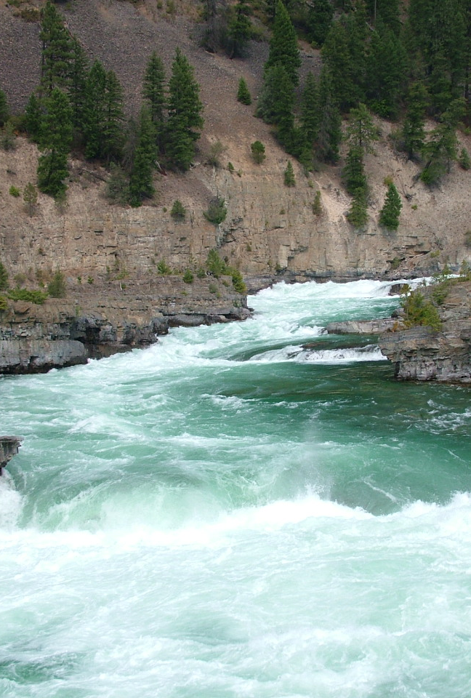
Future NWG Meetings
Notes:
TO CHANGE THE PHOTO: Double click the photo. Select change picture from the tool bar and select a photo from your files (or copy a photo from the end of this presentation and paste into here).

Slide 5
Tentative Schedule
Wednesday June 14, 2023 9:00 a.m. - 11:00 a.m.
Thursday July 20, 2023 9:00 a.m. - 11:00 a.m.
Wednesday August 16, 2023 9:00 a.m. - 11:00 a.m.
Thursday September 14, 2023 9:00 a.m. - 11:00 a.m.
5

Slide 6
Future Topics
How to select approvable nonpoint source projects/BMPs
Eligibility requirements and how to determine when to submit the AMP
DEQ resources and costs
Incentives
Interim permit limits
Training strategy
Fee structure
Updates on remaining tasks and document revisions
6

